Slide 1


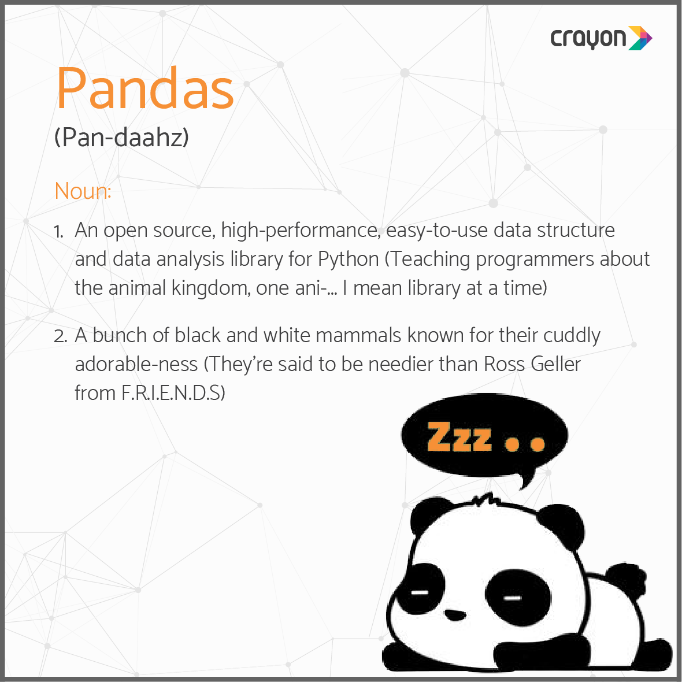
Data 100
Discussion #2
February 1st, 2023
Sign in here: https://tinyurl.com/data100-sp23-dis
Password: rahul2
Credit to Bella for these slides lol
Slides: https://tinyurl.com/rahul-slides

Slide 2
Announcements 🎉
Homework #1 is due 2/2 at 11:59 pm
Math 54 students – we are working on how to support your curriculum changes
Idk anything :(( but please see: https://edstem.org/us/courses/33744/discussion/2485542
if this affects you.
Slides: https://tinyurl.com/rahul-slides

Slide 3
We have met a lot of Pandas syntax this week!
DataFrames & Series
Accessing data with .iloc and .loc
Boolean filtering (&, |, ~)
Sampling with .sample
Grouping with .groupby
String operations with .str
Pivot tables with .pivot_table
Merging DataFrames with .merge
Assorted utility functions:
.head
.shape
.index
.columns
.sort_values
.value_counts
.unique
Don’t worry if this feels like information overload!
You will get lots of guided practice over the next few weeks

Slide 4
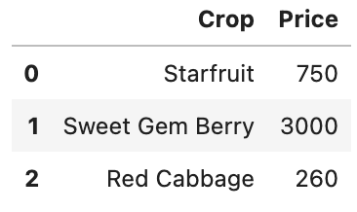
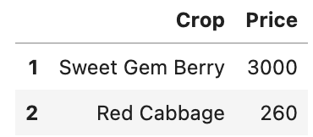
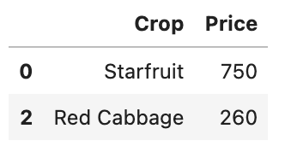
DataFrames & Series
.loc and .iloc accessors
In Pandas, tables are called DataFrames. We can think of them as a sequence of columns called Series.
We have two main ways of accessing rows and columns.
.loc[ ] lets us grab entries by their label:
df.loc[row_names, col_names]
>> farm.loc[1:2, :]
.iloc[ ] lets us grab entries by their index:
df.iloc[row_indices, col_indices]
>> farm.iloc[1:3, :]
This is a DataFrame:
farm = pd.DataFrame(
{“Crop”:[“Starfruit”, …], “Price”:[750,…]})
This is a series:
farm[“Price”]
🐼
Note that iloc is right-end exclusive!
Boolean filtering
Joining DataFrames using .merge
We can filter out rows of our DataFrame using a Boolean array of True and False values.
We can join two DataFrames using the .merge method. The DataFrames will pair up rows that share a common column.
First, apply a Boolean operator to the Series we want to use for filtering:
df[“column_name”] (<, >, ==, etc.) value
>> farm_bool = farm[“Price”] <= 1000
Then, use square brackets to filter out all False values from the DataFrame:
df[boolean_array]
>> farm[farm_bool]
pd.merge(df1, df2, left_on=“column_name”, \ right_on=“column_name”, how=join_type)
You’ll learn more about join types and primary/foreign key relationships when we study SQL in Week 11.

Slide 5
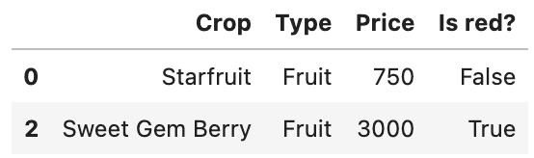
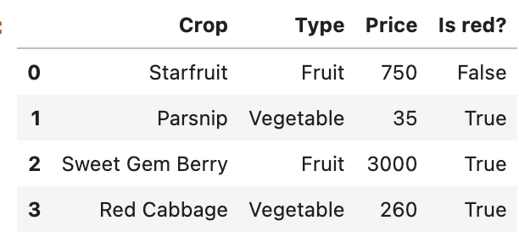
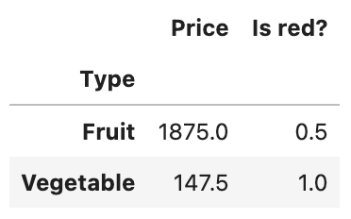
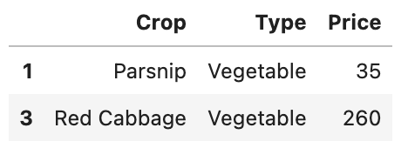
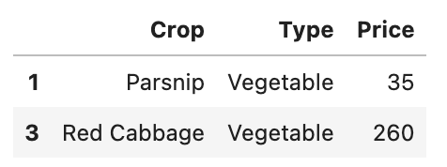
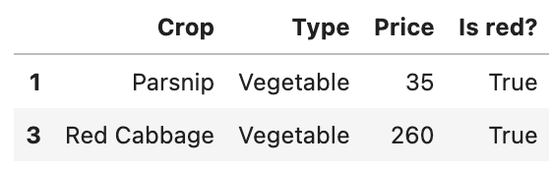
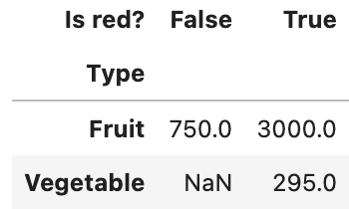
Grouping with .groupby
Filtering groups using .filter
If we want to group all entries by their type in a certain column, we can call df.groupby()
df.groupby(“column_name”).aggregator_func(func)
>> produce.groupby(“Type”).agg(np.mean)
Sometimes we only want to keep rows that belong to a group satisfying some condition.
produce.groupby(“Type”).filter(lambda df: df[“Price”].mean() < 200)
Here, our filter function takes in a DataFrame (a GroupBy subframe). It outputs one Boolean value. If True, all rows belonging to this group are kept in the final DataFrame. If False, all rows in this group are omitted.
Mean price of vegetables: 147.5
Mean price of fruit: 1875
So, only the vegetables are kept!
Original DataFrame
Subframes
Outputted DataFrame
🐼
.groupby(“Type”)
.agg(np.mean)
We can use many aggregator functions on a GroupBy object:
gb.agg(func) - applies func across each column of the subframes
gb.mean() - takes the mean across each column of the subframes
gb.sum() - takes the sum across each columns of the subframes
gb.first() - takes the first entry in each column of each subframe
gb.last() - takes the last entry in each column of each subframe
gb.filter(func) - filters out specific groups from the DataFrame
Creating pivot tables with .pivot_table
Sometimes we want to group our data by two columns:
pd.pivot_table(data=produce, index=“Type”, columns=“Is red?”, values=“Price”, aggfunc=sum)
index gives the rows of the table
columns gives the columns
To fill out the cells, we apply aggfunc to values

Slide 6
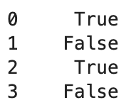
Manipulating strings with .str
A short(ish) list of important Pandas methods:
The .str accessory tells Pandas to perform operators on a Series of string data. This lets us manipulate every single string element in the Series, all at once. The process returns a new Series containing the manipulated strings.
df[“column_name”].str.str_func()
>> produce[“Crop”].str.startswith(“S”)
df.head() - gives the first n rows of the DataFrame
df.tail() - gives the last n rows of the DataFrame
df.shape - gives the dimensions of the DataFrame
df.rename() - renames the rows/columns of the DataFrame
df.set_index() - sets the index to the specified column
df.reset_index() - resets the index to the default 0, 1, 2...
df.relabel() - relabels specific entries in the DataFrame
df.drop() - removes the specified rows/cols from the DataFrame
df.sort_values() - sorts rows by the specified column
df.isna() - checks if values in the DataFrame are NaN
df.to_datetime() - converts times to Datetime objects
df.index - returns the index of the DataFrame
df.columns - returns an array of the column labels
df.copy() - creates a copy of the DataFrame
df.value_counts() - summarizes the count of each column combo
We can use many functions with .str:
.split(“delim”) - returns a list of substrings split at “delim”
.contains(“val”) - True if “val” is in the string, False otherwise
.startswith(“val”) - True if the string starts with “val”, False otherwise
.slice(start, end) - returns the substring sliced from start:end
[start:end] - returns the substring sliced from start:end
🐼

Slide 7
Other useful resources
Pandas Tutor: https://pandastutor.com/vis.html
Pandas user guide: https://pandas.pydata.org/docs/user_guide/index.html
Pandas API reference: https://pandas.pydata.org/docs/reference/index.html
Data 100 reference sheet: https://ds100.org/fa22/resources/assets/exams/sp22/mt1_reference_sheet.pdf

Slide 8
The Big Picture

Slide 9
Pandas
What is it? A Python library for manipulating tabular data (data stored in tables)
Why do we care? Pandas is our primary toolkit for cleaning, exploring, and modeling data
Common techniques in exams:
.groupby
What is it? A method for grouping all datapoints corresponding to a particular column value
Why do we care? .groupby is our go-to method to calculate aggregated measures across a certain class
.pivot_table
What is it? A method for assigning the index of a new DataFrame to values from one original column, and columns of a DataFrame to values from another original column
Why do we care? Pivot tables allow us to understand what values occur together in our data
.merge
What is it? A method for joining data across tables
Why do we care? Data is often stored in several tables; .merge allows us to collect all relevant info in one DataFrame

